Slide 1




Lesson 5
PARTNERS
Actions
Constraints
More buttons

Slide 2
Action

Slide 3












What is an action ?
Success
Open window, modify values, …
System response to user actions
login, action button, record selection, …
On condition
Raise Error

Slide 4







Action
<record id="test_model_action"
model="ir.actions.act_window">
<field name="name">Test action</field>
<field name="res_model">test.model</field>
<field name="view_mode">tree,form</field>
</record>
Can be defined in XML records → cfr chapter 5

Slide 5



In view deﬁnition
Adding button in your different views
2 mandatory attributes:
type="object"
name="action_do_something"
<button string="Do Something" type="object" name="action_do_something" />
OR use type="action" and we refer the external identifier in name attribute
<button string="My Action" type="action" name="%(test.action_do_something)d"/>

Slide 6





Business logic
from odoo import fields, models
class TestAction(models.Model):
_name = "test.action"
Define a public method (does not start with “_”)
name = fields.Char()
Make them do what you want !
→ update fields, create/delete records…
def action_do_something(self):
for record in self:
record.name = "Something" return True

Slide 7




Business logic
from odoo import fields, models
Can also be used to open views
(same as actions in chapter 5)
class TestAction(models.Model):
_name = "test.action"
def action_open_something(self): self.ensure_one()
return {
"type": "ir.actions.act_window", "name": "Test action",
"res_model": "test.model", "view_mode': "form",
Return a dict with same values
as defined in XML data records
}
<button type="object" name="action_open_something" string="Do Something" />

Slide 8
Business logic
Can pass more complex arguments
res_id
(form view) specific record to load
from odoo import fields, models
class TestAction(models.Model):
_name = "test.action"
context
additional data loaded in the context
def action_open_something(self): self.ensure_one()
return {
"type": "ir.actions.act_window", "name": "Test action",
"res_model": "test.model", "view_mode': "form",
"res_id": self.child_id.id,
}
domain
filtering domain added in view search queries
-> Many other (see doc)
(args also possible to use in XML data records)
<button type="object" name="action_open_something" string="Do Something" />

Slide 9



Raising error
from odoo import fields, models
from odoo.exceptions import UserError
Under condition, blocfi the action
class TestModel(models.Model):
_name = "test.model"
_description = "Test Model"
Different types of errors
amount = fields.Float() total = fields.Float()
UserError used if user tries to do something that has no sense given the current state of a record
def action_do_something(self):
for rec in self:
if rec.total < 0:
raise UserError(_("Total should be positive")) rec.amount = rec.total / 10
return True
Text returned in error can be made translatable using " _( … ) "

Slide 10
Constraints

Slide 11




Constraint Types
SQL
Python
VS

Slide 12


SQL constraint
Defined in the model attribute _sql_constraints in the python file
_sql_constraints = [(name, sql_condition, error_message)]
SQL conditions can use different types of constraints:
Check Constraints
Not-Null Constraints
Unique Constraints
Primary Keys
Foreign Keys
Exclusion Constraints

Slide 13



SQL constraint
Example :
from odoo import fields, models
class TestModel(models.Model):
_name = "test.model"
_description = "Test Model"
price = fields.Float() name = fields.Char()
_sql_constraints = [
("check_price", "CHECK(price > 0)", "Price should be positive."), ("check_unique_name", "UNIQUE(name)", "Name must be unique.")
]

Slide 14

Python constraint
from odoo import api, fields, models, ValidationError
For complex checks require Python code
class TestModel(models.Model):
_name = "test.model"
_description = "Test Model"
date = fields.Date()
Defined using api decorator "constrains" on method
@api.constrains("date")
def _check_date_end(self):
for record in self:
if record.date < fields.Date.today():
raise ValidationError(_("The end date cannot be set in the past"))
Should raise ValidationError if the validation failed.
Remember about the underscore "_(...)" for the translations

Slide 15


Technicalities
SQL constraints are usually more efficient than Python ones
@constrains only supports simple field name (ex: partner_id.customer)
@constrains will be triggered only if fields are in the create() or write() call.
Working with float : Use float_compare() or float_is_zero()
(from odoo.tools.float_utils)

Slide 16
More buttons

Slide 17

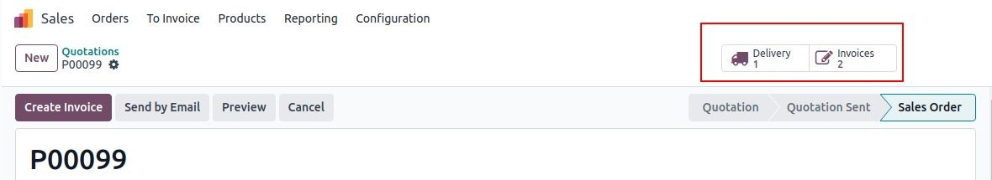

Stat button
Allows users to open views to display related records
Can show a counter of those records

Slide 18


Button deﬁnition
from odoo import _, fields, models
Define a public method
in the class
class TestModel(models.Model):
_name = "test.model"
_description = "Test Model"
return a dictionary
line_ids = fields.One2many("related.model", "field_id")
def action_open_line_ids(self):
return {
"name": _("Related Lines"),
"type": "ir.actions.act_window",
"view_mode": "tree,form",
"res_model": "related.model",
"target": "current",
"domain": [("id", "=", self.id)], "context": {"default_field_id": self.id},
}
→ keys will be same elements as fields defined in action record defined in the data
(without id needed)
domain → display all the elements with this field as inverse field
context → if new record created then, links it to source record

Slide 19



Button deﬁnition
class TestModel(models.Model):
…
def action_open_line_ids(self):
…
In the view, add a <div> with the class oe_button_box
Inside, add a <button>
→ name attribute must be the same name of the method
→type attribute must "object"
→class attribute must be "oe_stat_button"
→ chose an fa-icon
<form>
<sheet>
<div class="oe_button_box" name="button_box">
<button name="action_open_line_ids" type="object" class="oe_stat_button" icon="fa-icon" />
</div>
…
</sheet>
</form>

Slide 20






Button deﬁnition
from odoo import _, fields, models
class TestModel(models.Model):
_name = "test.model"
_description = "Test Model"
line_count = fields.Integer(compute="_compute_line_count") @api.depends("line_ids")
def _compute_line_count(self):
for rec in self:
rec.line_count = len(rec.line_ids)
Add a counter !
Deﬁne new computed ﬁeld in model
Add the ﬁeld in the view, inside button tags
<div class="oe_button_box" name="button_box" >
<button name="action_open_line_ids" … >
<field name="line_count" string="Lines" widget="line_count"/>
</button>
</div>

Slide 21

Exercise
Set a property as sold or cancelled.
Lesson 5
Action
Add the buttons ‘Cancel’ and ‘Sold’ to the estate.property model. A canceled property cannot be set as sold, and a sold property cannot be canceled.
Tip: in order to raise an error, you can use the UserError function.
Add the buttons ‘Accept (v)’ and ‘Refuse (x)’ to the
estate.property.offer model list view.
Tip: to use an icon as a button, have a look at this example.
When an offer is accepted, set the buyer and the selling price for the corresponding property.
Pay attention: in real life only one offer can be accepted for a given property!

Slide 22

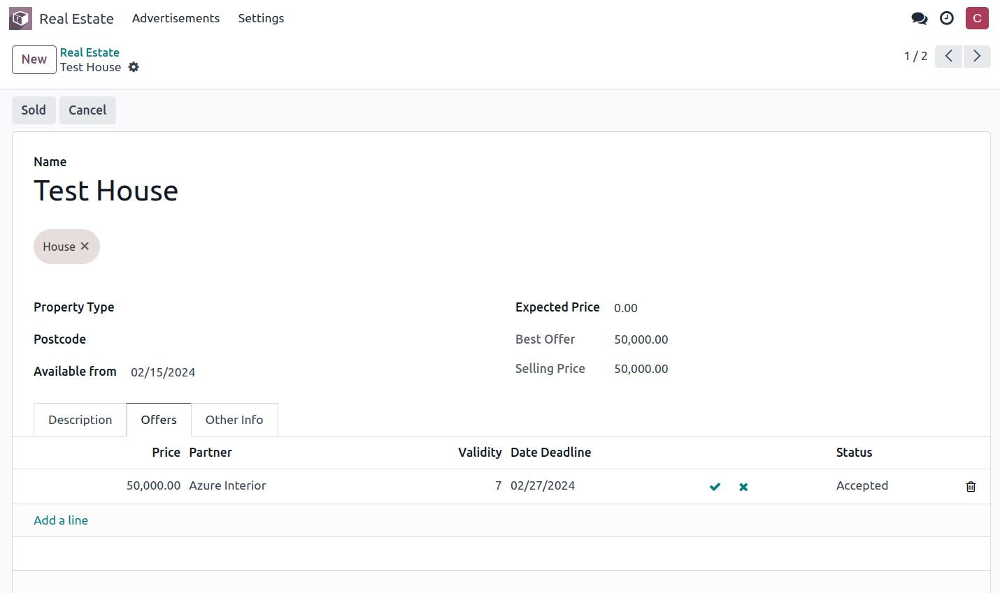
Exercise
Lesson 5
Action

Slide 23
Exercise
Lesson 5
Action
SQL constraints
Add SQL constraints.
Add the following constraints to their corresponding models:
A property expected price must be strictly positive
A property selling price must be positive
An offer price must be strictly positive
A property tag name and property type name must be unique
Tip: search for the unique keyword in the Odoo codebase for examples of unique names.

Slide 24
Exercise
Lesson 5
Action
SQL constraints
Python constraints
Add Python constraints.
Add a constraint so that the selling price cannot be lower than 90% of the expected price.
Ensure the constraint is triggered every time the selling price or the
expected price is changed!
Tip: the selling price is zero until an offer is validated. You will need to fine tune your check to take this into account.

Slide 25
Exercise
Add the field property_type_id to estate.property.offer.
Lesson 5
Action
SQL constraints
Python constraints
Button context
Lesson 5
Action
SQL constraints
Python constraints
Button context
We can define it as a related field on property_id.property_type_id
and set it as stored.
Thanks to this field, an offer will be linked to a property type when it’s created. You can add the field to the list view of offers to make sure it works.
Add the field offer_ids to estate.property.type which is the One2many inverse of the field defined in the previous step.
Add the field offer_count to estate.property.type.
It is a computed field that counts the number of offers for a given property type (use offer_ids to do so).

Slide 26
Exercise
Lesson 5
Action
SQL constraints
Python constraints
Button context
Chapter 17
Button context Stat Button
Lesson 5
Action
SQL constraints
Python constraints
Button context
Stat button
Display the list of offers when clicking on the stat button.
Create a stat button on estate.property.type pointing to the
estate.property.offer action.
This means you should use the type="action" attribute.
At this point, clicking on the stat button should display all offers. We still need to filter out the offers.
On the estate.property.offer action, add a domain that defines
property_type_id as equal to the active_id (= the current record)
CLICK HERE

